Slide 1

CSE- 321
Software Engineering
Lecture : 04 Systems
Fahad Ahmed
Lecturer, Dept. of CSE
E-mail: fahadahmed@uap-bd.edu

Slide 2
Lecture Outlines
What is a System?
Socio-Technical System
Systems Engineering
System Design Process
Legacy Systems
Critical System
System Dependability
Dependability Costs Curve

Slide 3
System
What is a system?
A purposeful collection of inter-related components working together to achieve some common objective.
A system may include software, mechanical, electrical and electronic hardware and be operated by people.
System components are dependent on other system components.
System categories
Technical computer-based systems
Socio-technical systems

Slide 4
Socio-technical system characteristics
Socio-technical system characteristics
Emergent properties
Properties of the system of a whole that depend on the system components and their relationships.
Non-deterministic
They do not always produce the same output when presented with the same input because the system's behaviour is partially dependent on human operators.
Complex relationships with organizational objectives
The extent to which the system supports organizational objectives does not just depend on the system itself.

Slide 5
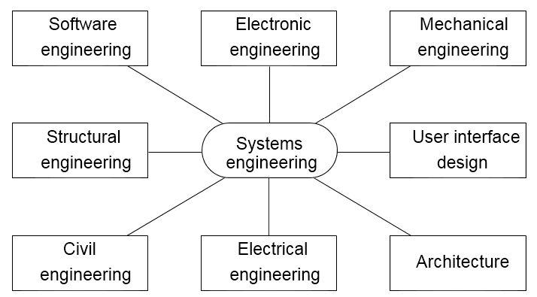
Systems engineering
Systems engineering is the activity of specifying, designing, implementing, validating, deploying and maintaining socio-technical systems.
Systems engineers are not just concerned with software but also with hardware and the system’s interactions with users and its environment.
Concerned with the services provided by the system, constraints on its construction and operation and the ways in which it is used.
Disciplines involved in systems engineering

Slide 6
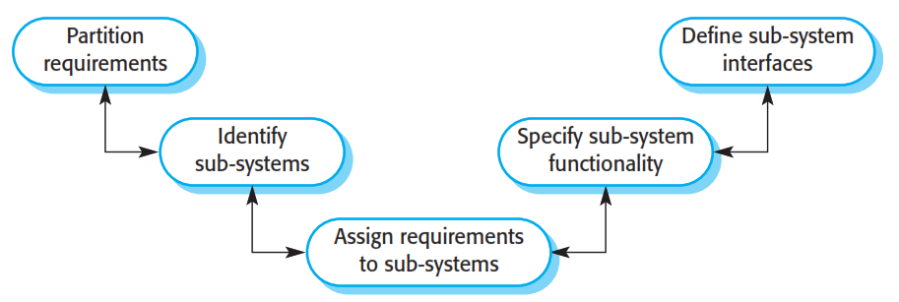
System design
The system design process

Slide 7
Legacy systems
Legacy systems are socio-technical computer-based systems that have been developed in the past, often using older or obsolete technology.
These systems include not only hardware and software but also legacy processes and procedures—old ways of doing things that are difficult to change because they rely on legacy software.
– Bank customer accounting system.

Slide 8
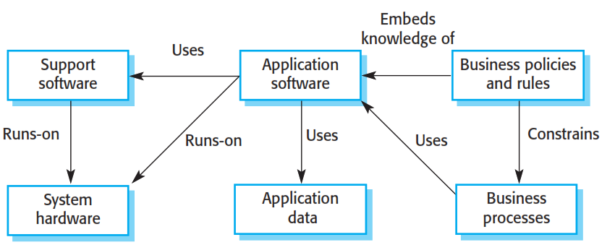
Legacy system components

Slide 9
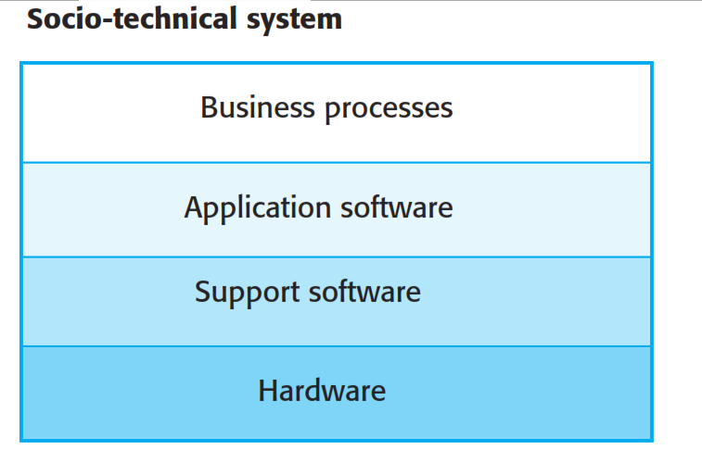
Layered model of legacy system

Slide 10
Critical System
Critical System
It is the systems that fail to deliver the expected objective in which any system failure can result in economic losses, physical damage or human life loss.
There are three main types of critical systems:
Safety-critical systems
Failure results in loss of life, damage to the environment;
Chemical plant protection system
Mission-critical systems
Failure results in failure of some goal-directed activity;
Spacecraft navigation system
Business-critical systems
Failure results in high economic losses;
Customer accounting system in a bank

Slide 11
System Dependability
The dependability of a computer system is a property of the system that reflects the user’s degree of trust in the system.
Principal dimensions of dependability are:
Availability
Reliability
Safety
Security

Slide 12
Dimensions of System Dependability

Slide 13
Other dependability properties
Repairability
Reflects the extent to which the system can be repaired in the event of a failure.
Maintainability
Reflects the extent to which the system can be adapted to new requirements.
Survivability
Reflects the extent to which the system can deliver services whilst under hostile attack.
Error tolerance
Reflects the extent to which user input errors can be avoided and tolerated.

Slide 14
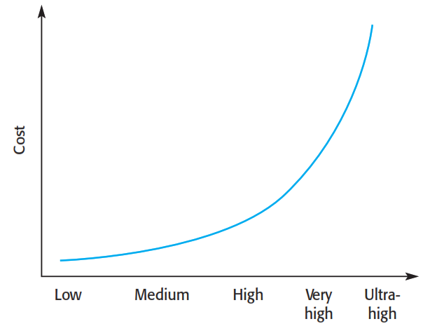
Dependability Costs Curve
Dependability costs tend to increase exponentially as increasing levels of dependability are required
There are two reasons for this
The use of more expensive development techniques and hardware that are required to achieve the higher levels of dependability
The increased testing and system validation that is required to convince the system client that the required levels of dependability have been achieved

Slide 15
Sample Question
Consider a security system which is intended to protect against intrusion and to detect fire. It incorporates smoke sensors, movement sensors, door sensors, video cameras under computer control, located at various places in the building, an operator console where the system status is reported, and external communication facilities to call the appropriate services such as the police and fire departments.
Draw a block diagram of a possible design for such a system.

Slide 16
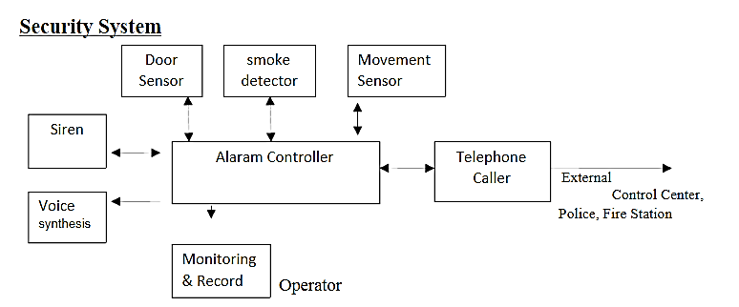
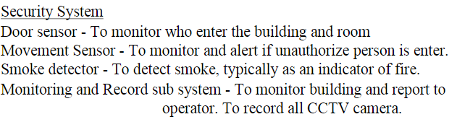

Sample Question

Slide 17
Lecture Outlines
Software Development Lifecycle
Software Processes
Software Requirement Specification
Software Process Model

Slide 18
Software Development Life Cycle
What is SDLC?
SDLC stands for Software Development Lifecycle. SDLC is a systematic process for building software that ensures the quality and correctness of the software built. SDLC process aims to produce high-quality software that meets customer expectations.
Why SDLC?
It offers a basis for project planning, scheduling, and estimating
Provides a framework for a standard set of activities and deliverables
It is a mechanism for project tracking and control
Increases visibility of project planning to all involved stakeholders of the development process
Increased and enhance development speed
Improved client relations
Helps you to decrease project risk and project management plan overhead

Slide 19
Software Development Life Cycle
SDLC Phases
The entire SDLC process divided into the following stages:
Phase 1: Requirement collection and analysis
Phase 2: Feasibility study
Phase 3: Design
Phase 4: Coding
Phase 5: Testing
Phase 6: Installation/Deployment
Phase 7: Maintenance

Slide 20
Software Development Life Cycle
Phase 2: Feasibility study
This process conducted with the help of 'Software Requirement Specification' document also known as 'SRS' document.
There are mainly five types of feasibilities checks:
Economic
Legal
Operation feasibility
Technical
Schedule
Phase 3: Design:
In this third phase, the system and software design documents are prepared as per the requirement specification document. This helps define overall system architecture.

Slide 21
Software Development Life Cycle
Phase 3: Design:
There are two kinds of design documents developed in this phase:
High level design (HLD): It give the architecture of software product.
Low level design (LLD): It describe how each and every feature in the product should work and every component.
High-Level Design (HLD)
Brief description and name of each module
An outline about the functionality of every module
Interface relationship and dependencies between modules
Database tables identified along with their key elements
Complete architecture diagrams along with technology details

Slide 22
Software Development Life Cycle
Phase 3: Design:
Low-Level Design(LLD)
Functional logic of the modules
Database tables, which include type and size
Complete detail of the interface
Addresses all types of dependency issues
Listing of error messages
Complete input and outputs for every module

Slide 23
Software Development Life Cycle
Phase 7: Maintenance:
Once the system is deployed, and customers start using the developed system, following 3 activities occur
Bug fixing - bugs are reported because of some scenarios which are not tested at all
Upgrade - Upgrading the application to the newer versions of the Software
Enhancement - Adding some new features into the existing software
For more details: https://www.guru99.com/software-development-life-cycle-tutorial.html

Slide 24

Thanks to All

